Slide 1
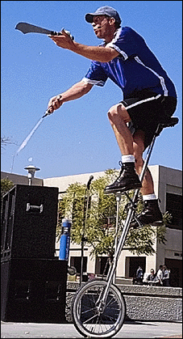
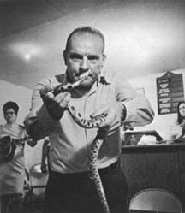

Quality Risk Analysis
A Hands-On Workshop
Rex Black
RBCS, Inc.
31520 Beck Road
Bulverde, TX 78163 USA
Ph: +1 (830) 438-4830
Fax: +1 (830) 438-4831
www.rexblackconsulting.com
rex_black@rexblackconsulting.com

Slide 2
What is Quality Risk Analysis?
Quality Risk Analysis
A Hands-On Workshop

Slide 3
What Does “Quality” Mean to You?
A definition from J. M. Juran:
  Fitness for use. Features [that] are decisive as to product performance and as to ‘product satisfaction’…. The word ‘quality’ also refers to freedom from deficiencies…[that] result in complaints, claims, returns, rework and other damage. Those collectively are forms of ‘product dissatisfaction.’
Testing usually focuses on deficiencies and sources of dissatisfaction
Testing can…
  assess quality risks
  discover existing bugs
  allow the project team to manage risks to system quality

Slide 4

What’s a Quality Risk?
Risk
  The possibility of a negative or undesirable outcome
  The likelihood of a risk becoming an outcome is…
  >0, <1 in the future…
  0 or 1 in the past
Quality risk
  The possibility that the system will fail to satisfy customers, users, or other stakeholders
  A family of possible bugs are behind quality risks

Slide 5
How Can We Analyze Quality Risks?
Informal | ISO 9126 | Failure Mode and Effect Analysis
Start with the classic quality risk categories | Start with six main quality characteristics | Start with categories, char-acteristics, or subsystems
Functionality, states and transactions, capacity and volume, data quality, error handling and recovery, performance, standards and localization, usability, etc. | Functionality, Reliability, Usability, Efficiency, Maintainability, Portability (FRUEMP), then decompose into key subcharacteristics for your system | Key stakeholders list possible failure modes, predict their effects on system, user, society, etc., assign severity, priority, and likelihood, then calculate risk priority number (RPN)
Set priority for testing each quality risk with key stakeholders | Set priority for testing each subcharacteristic with key stakeholders | Stakeholders use RPN to guide appropriate depth and breadth for testing
Regardless of technique the keys are cross-functional stakeholder participation, consensus, and a best-possible-outcome outlook

Slide 6
Quality risks are potential system problems which could reduce user satisfaction
Risk priority number: Aggregate measure of problem risk
Tracing information back to requirements, design, or other risk bases
Business (operational) risk: Impact of the problem
Technical risk: Likelihood of the problem
Quality Risk | Tech. Risk | Bus. Risk | Risk Pri. # | Extent of Testing | Tracing
Risk Category 1
Risk 1
Risk 2
Risk n
A hierarchy of risk categories can help organize the list and jog your memory.
1 = Very high
2 = High
3 = Medium
4 = Low
5 = Very low
The product of technical and business risk, from 1-25.
1-5 = Extensive
6-10 = Broad
11-15 = Cursory
16-20 = Opportunity
21-25 = Report bugs

Slide 7
Tips for Risk Analysis
Use a cross-functional brainstorming team
  Sometimes it’s easier to come up with the risks first, then assign the risk values
Only separate risk items when necessary to distinguish between different levels of risk
  Long documents hard to use, “forest-for-trees”
Consider technical and business risk
  Technical risk: likelihood of problem, impact of problem on system
  Business risk: likelihood of usage, impact of problem on users
Follow up and re-align risk analysis, testing, and the project at key project milestones

Slide 8
Challenges of Risk Analysis
Building inter-rater agreement (consensus) on risk
  Political influence, horse-trading, and education
Avoiding priority inflation
  Sure, everything is priority 1, but what would you give up?
  Can also explicitly consider costs in relation to risks
Making rational decisions about risk
  Which is safer, air travel or driving?
Investing the time
  Risk analyses can be lengthy processes
Categorization is not quantification
  When numerical scales are used for risks, what kind of numbers are these…really?

Slide 9
Examples of Quality Risk Analysis
Quality Risk Analysis
A Hands-On Workshop

Slide 10
Quality Risk | Tech. Risk | Bus. Risk | Risk Priority | Extent of Testing
Functionality
User login and authentication fails | 2 | 1 | 2 | Comprehensive
User can’t view transactions in accounts | 3 | 1 | 3 | Comprehensive
Localization
Spanish language translation doesn’t fit fields | 2 | 3 | 6 | Broad
Spanish language messages wrong, insulting, etc. | 4 | 3 | 12 | Cursory
Usability and User Interface
User gets “stuck” in screen flows, esp. on error | 4 | 2 | 8 | Broad
User finds interface too complex | 4 | 1 | 4 | Comprehensive
Reliability
Less than 95% availability from 4:00 AM to 2:00 AM. | 4 | 2 | 8 | Broad
Performance
System responses > 0.5 seconds under full load | 5 | 2 | 10 | Broad
Supportability
Patches and releases won’t install correctly | 5 | 4 | 20 | Opportunity
Patches and releases require extensive downtime | 5 | 3 | 15 | Cursory

Slide 11
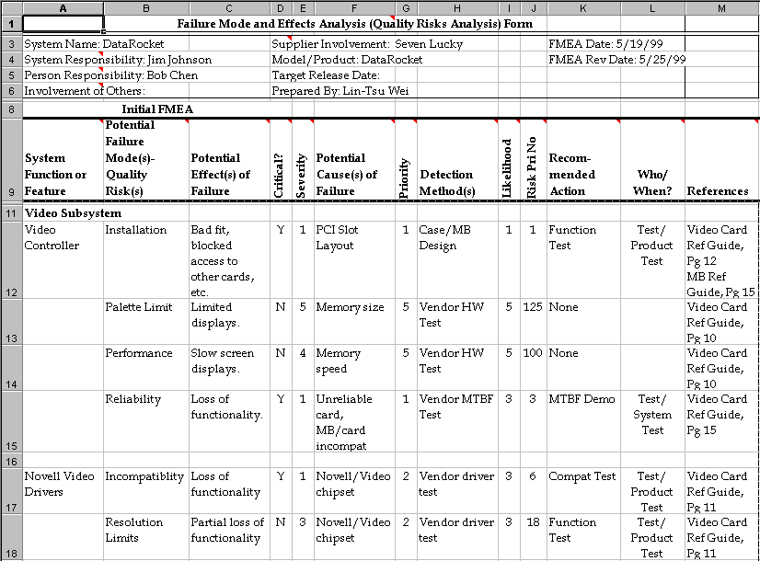
Subsystem-Based FMEA

Slide 12
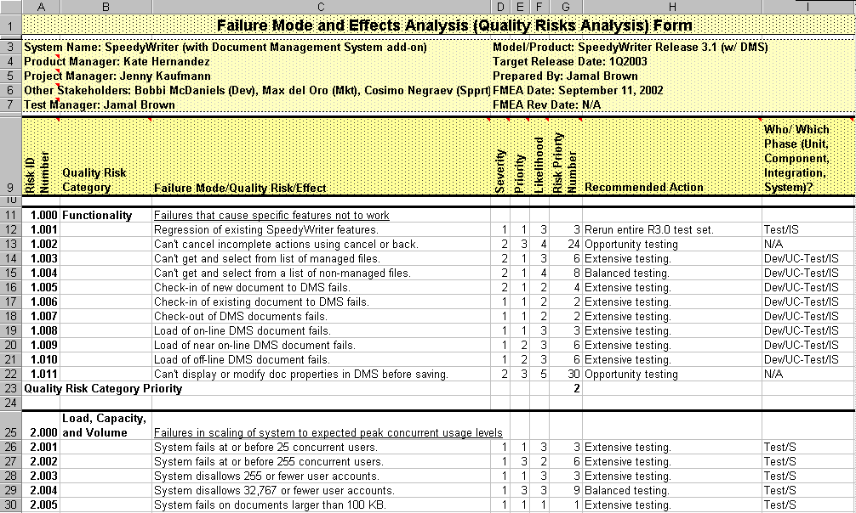
Risk Category-Based FMEA

Slide 13
Case Studies:
Internet Appliance and File Utility
Quality Risk Analysis
A Hands-On Workshop

Slide 14
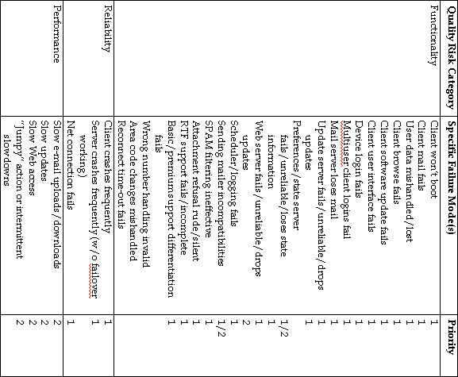

Slide 15
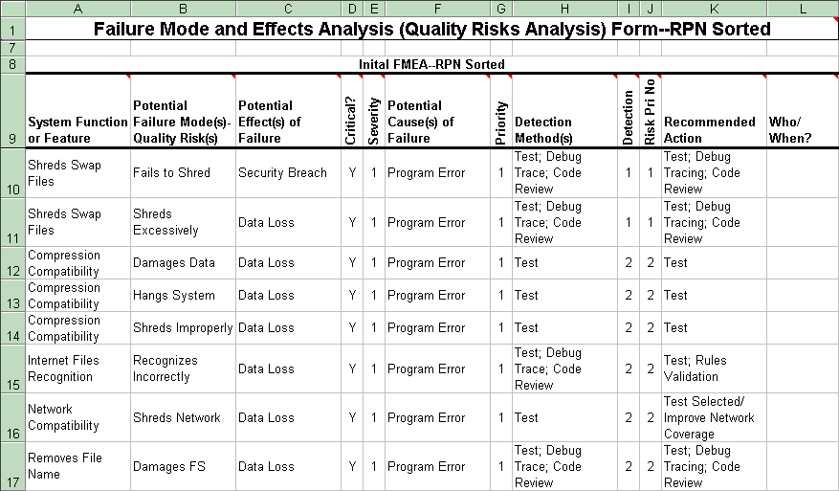

Slide 16
Exercise:
Analyzing Quality Risks
Quality Risk Analysis
A Hands-On Workshop

Slide 17
Exercise: Quality Risk Analysis
Analyze quality risks for Omninet, based on the Omninet Marketing Requirements Document
  Use the informal technique (unless you know ISO or FMEA)
  I have provided a template with a few categories
  Don’t feel compelled to fill the templates!
Use priority to guide testing in each risk area
  Extensive testing. Test entire area, with many variations
  Broad testing. Test the entire area, but few variations
  Cursory: Test a sample of the area
  Opportunity testing: Test if some other test brings you to the area
  Report bugs: If you see problems in this area, report them
Retaining tracing information between MRD and risk

Slide 18
Quality Risk | Tech. Risk | Bus. Risk | Risk Priority | Extent of Testing | Tracing
Functionality

Slide 19
Quality Risk | Tech. Risk | Bus. Risk | Risk Priority | Extent of Testing | Tracing
Localization

Slide 20
Quality Risk | Tech. Risk | Bus. Risk | Risk Priority | Extent of Testing | Tracing
Usability and User Interface

Slide 21
Quality Risk | Tech. Risk | Bus. Risk | Risk Priority | Extent of Testing | Tracing
Reliability

Slide 22
Quality Risk | Tech. Risk | Bus. Risk | Risk Priority | Extent of Testing | Tracing
Performance

Slide 23
Quality Risk | Tech. Risk | Bus. Risk | Risk Priority | Extent of Testing | Tracing
Supportability

